Slide 1

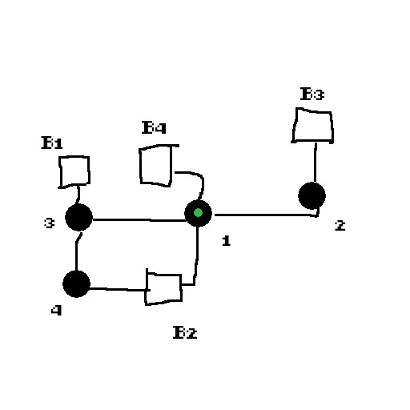
PITCH CONCEPT
GAME NAME: Darkara
VERSION: 15/01/2025
SYNOPSIS
Darkara is a planet known for its natural production of graphan energy, used in Trygun ships as fuel.
One day, an unknown race begins an invasion of the planet. After attempts to defend itself and thousands of deaths, the population begins to evacuate.
During the evacuation, the Carpentier (a mass evacuation ship) begins to be attacked and a man named Jhimy, a soldier in the defense army, enters his Ghumn ship to try to stop the attempt to destroy the ship.
HOW TO PLAY
Left and right arrows: Rotate
Up arrow: Accelerate
D key: Attack / Interact
S key: Impulse
Esc key: Cancel / Back
You control the Ghumn ship, a Trygun-type ship used by Jhimy for several years. You have 3 lives and cannot recover during gameplay. After starting the game, you must defeat the generals in order to win the game. The game ends after defeating the last general of the troops.
This game is part of the Ghumn games universe.
DIFFERENTIALS
Some of the differentials that can be mentioned are bosses with different mechanics, simplified movement and attack, movement around the map and stylized models.
TEAM(members): Daniel(Lekrieg), Vinicius(Yper51)

Slide 2
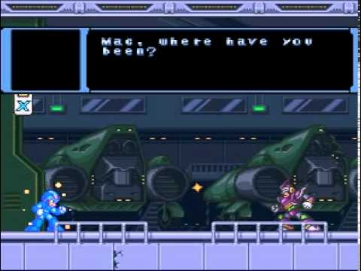
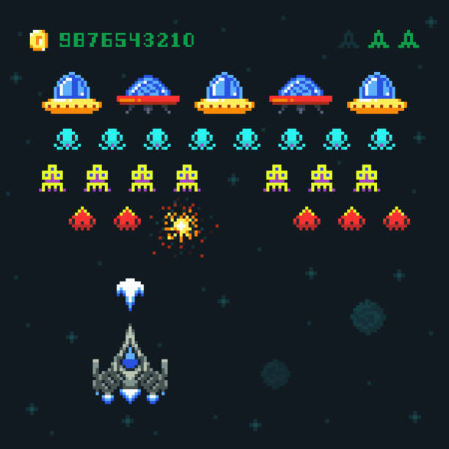
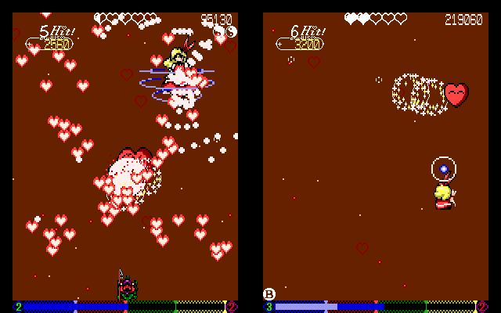
REFERENCES
Game references / genres / mechanics / aesthetics / image universes / stories
Dialog box style - Megaman
Enemy waves - Space invaders
Simple pixel art – Tōhō: Yumejikū
Page
1
of
1

